Slide 1
Counselling of adolescent women on contraceptive methods
Educational Slide Kit
Module 2: Overcoming the barriers to effective counselling of adolescents about contraception
G.MKT.WH.FC.07.2016.0862
Notes:
The global CARE group is a panel of independent physicians from 13 countries with expert interest in sexual and reproductive health in adolescence.
Formation of the CARE group and its ongoing work is supported by Bayer Pharma AG.
For further information on the development and use of this Slide Kit, please refer to the Introduction and terms of use slide set.

Slide 2
Module content
The specific contraceptive needs of adolescent women
Using three key principles to address the contraceptive counselling needs
Providing access, confidentiality and education
The role of healthcare providers as a trusted source of information
Effective interventions to enhance continuous and consistent use of contraception

Slide 3
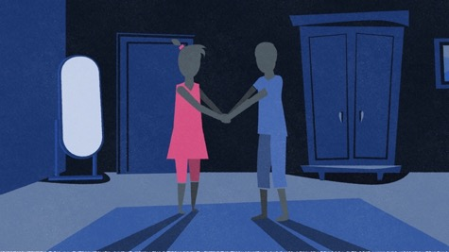
Adolescents have the right to a sex life that is as safe and as pleasurable as possible¹
The provision of contraception to adolescents:²
should be holistic
take their sexual and reproductive health needs into account
consider all medically appropriate options
No method of contraception should be excluded based on adolescent age alone³
1. Bitzer J, et al. Eur J Contracept Reprod Health Care 2016;21:6,417-430; 2. International Conference on Population and Development. Beyond 2014 Review. Available at: http://www.unfpa.org/icpd. Accessed 10 April 2015; 3. WHO. Medical eligibility criteria for contraceptive use. 5th ed. Geneva: WHO; 2015.
Notes:
Speaker notes:
Adolescents have the right to a sex life that is as safe and as pleasurable sex as possible.¹
Although long-acting reversible contraceptive (LARC) methods have been emphasized as a contraceptive option for adolescents by professional organisations and some health authorities,^{2,3,4} difficulties with accessibility and acceptability of LARC methods are evident.¹ Thus, health care providers must develop and maintain counselling skills for the provision of all methods of short- and long-acting contraception.
The provision of contraception to adolescents:⁵
should be holistic
take their sexual and reproductive health needs into account
consider all medically appropriate options
No method of contraception should be excluded based on adolescent age alone.⁶
References [please note, references on the slide differ slightly from those included in the notes]:
Bitzer J, Abalos V, Apter D, Martin R, Black A, on behalf of the Global CARE (Contraception: Access, Resources, Education) Group. Targeting factors for change: Contraceptive counseling and care of adolescent women. Eur J Contracept Reprod Health Care 2016;21:6,417-430
American College of Obstetricians and Gynecologists. Long-acting reversible contraception: implants and intrauterine devices. Practice Bulletin No. 121. Obstet Gynecol 2011;118:184–96.
American Academy of Pediatrics; Committee on adolescence. Policy statement. Contraception for adolescents. Pediatrics 2014;134(4):e1244–56.
National Institute for Health and Care Excellence. Contraceptive services with a focus on young people up to the age of 25. NICE public health guidance 15, March 2014.
International Conference on Population and Development. Beyond 2014 Review. Available at: http://www.unfpa.org/icpd.
WHO. Medical eligibility criteria for contraceptive use. 5th ed. Geneva: WHO; 2015.

Slide 4
Adolescent women are at greater risk of unintended pregnancy than older women
Poor risk perception and lack of skills to evaluate consequences¹
Lack of sex education and knowledge regarding pregnancy prevention²
Delays in accessing or an inability to access contraception^{2,3}
Incorrect, inconsistent or lack of use of contraception^{3,4}
Avoidance of effective methods due to safety fears^{5,6}
Difficulties in discussing contraception with partners⁷
All these factors mean that adolescents need to be counseled differently to older women
1. Amu O, Appiah K. Eur J Contraception Reprod Health Care 2006;11(4):314–318; 2. World Health Organization. Adolescent Pregnancy Fact Sheet no. 364, updated Sept 2014; 3. Meyrick J. J Fam Planning Reprod Health Care 2001;27:33–36; 4. Vaughan B, et al. Contraception 2008;78(4):271–83; 5. Craig AD, et al. Women Health Issues 2014;24(3):e281–9. 6. Gilliam ML, et al. J Pediatr Adolesc Gynecol 2009;22(2):97-104; 7. Manlove J, et al. Perspect Sexual Reprod Health 2004;36(6):265–275.
Notes:
Speaker notes:
However, adolescent women are at high risk of unintended pregnancy because they:
Have poor perception of risk and are ill-equipped to evaluate the consequences.¹
Lack the education and knowledge regarding prevention of pregnancy.²
Either delay access to contraception or lack access to contraception.^{2,3}
Use contraception incorrectly, inconsistently or not at all.^{3,4}
May avoid effective methods due to fears around side effects.^{5,6}
Have difficulties discussing use of contraception.⁷
Therefore, adolescent women need to be counseled differently to older women.
References:
Amu O, Appiah K. Teenage pregnancy in the United Kingdom: Are we doing enough? Eur J Contraception Reprod Health Care 2006;11(4):314–318.
World Health Organization. Adolescent Pregnancy Fact Sheet no. 364, updated Sept 2014. Available at: http://www.who.int/mediacentre/factsheets/fs364/en/.
Meyrick J. Repeat use of contraceptive crisis services among adolescent women. J Fam Planning Reprod Health Care 2001;27:33–36.
Vaughan B, Trussell J, Kost K, Singh S, Jones R. Discontinuation and resumption of contraceptive use: results from the 2002 National Survey of Family Growth. Contraception 2008;78(4):271–83.
Craig AD, Dehlendorf C, Borrero S, et al. Exploring young adults’ contraceptive knowledge and attitudes: disparities by race/ethnicity and age. Women Health Issues 2014;24(3):e281–9.
Gilliam ML, et al. Contraceptive attitudes among inner-city African American female adolescents: Barriers to effective hormonal contraceptive use. J Pediatr Adolesc Gynecol 2009;22(2):97-104.
Manlove J, et al. Contraceptive use and consistency in US teenagers’ most recent sexual relationships. Perspect Sexual Reprod Health 2004;36(6):265–275.

Slide 5
Adolescents are also exposed to greater risk of sexually transmitted infection
Prevalence rates of many STIs are highest among adolescents^{1,2}
Women aged <25 years have the highest rates of chlamydia¹
Rate (per 1000,000 population)
Men
Women
4000
3200
2400
1600
800
0
Age
0
800
1600
2400
3200
4000
14.7
10-14
108.9
715.2
15-19
3043.3
1325.6
20-24
3621.1
757.9
25-29
1428.3
390.9
30-34
599.2
207.5
35-39
273.4
116.6
40-44
118.3
55.9
45-54
41.4
17.0
55-64
11.3
4.0
65+
2.5
262.6
Total
623.1
Rates of reported cases of chlamydia by age and sex, United States, 2013
1. Murray PJ, et al. Pediatrics 2014;134:e302–e311; 2. Centers for Disease Control and Prevention. (2014, December). Accessed at:http://www.cdc.gov/std/stats13/surv2013-print.pdf.
Notes:
Speaker notes:
Prevalence rates of many sexually transmitted infections (STIs) are highest among adolescents.^{1,2}
STI screening aims to identify and treat individuals with treatable infections, reduce transmission to others, avoid or minimize long-term consequences, identify other exposed and potentially infected individuals, and decrease the prevalence of infection.¹
References:
Murray PJ, et al. Policy Statement: Screening for Nonviral Sexually Transmitted Infections in Adolescents and Young Adults. Pediatrics 2014;134:e302–e311.
Centers for Disease Control and Prevention. (2014, December). Sexually transmitted disease surveillance, 2013. Accessed at:http://www.cdc.gov/std/stats13/surv2013-print.pdf

Slide 6
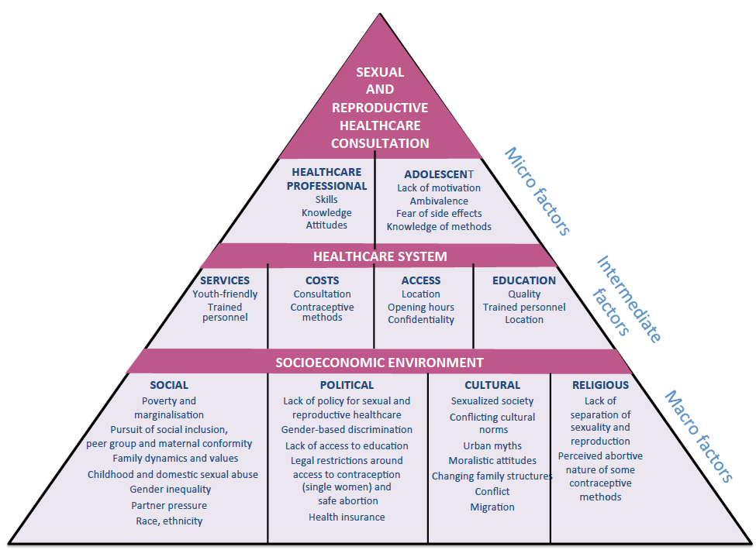
Adolescents face unique, multi-dimensional barriers when accessing sexual and reproductive healthcare¹
Reducing the risk of unintended pregnancy in these women therefore requires a multi-dimensional approach¹
Barriers to sexuality education and contraceptive services need to be addressed¹
Education content and delivery should be tailored to meet the specific needs of adolescents¹
1. Bitzer J, et al. Eur J Contracept Reprod Health Care 2016;21:6,417-430
Notes:
Speaker notes:
The barriers influencing sexual and reproductive health in adolescents are multi-dimensional, therefore reducing the risk of unintended pregnancy in these women requires a multi-dimensional approach.¹
Although some factors are universal, such as the biological changes associated with puberty, the macro, intermediate and micro factors depicted here may vary significantly from region to region.¹
However, irrespective of location:¹
Barriers to sexuality education and contraceptive services need to be addressed.
Education content and delivery should be tailored to meet the specific needs of adolescents.
References:
Bitzer J, Abalos V, Apter D, Martin R, Black A, on behalf of the Global CARE (Contraception: Access, Resources, Education) Group. Targeting factors for change: Contraceptive counseling and care of adolescent women. Eur J Contracept Reprod Health Care 2016;21:6,417-430

Slide 7
Three key principles can address the majority of adolescent contraceptive needs¹
ACCESS to non-judgmental, youth-friendly, timely and convenient contraceptive services^{1,2}
Assurance of CONFIDENTIALITY ¹
Provision of holistic EDUCATION programmes that address biological and psychosocial needs¹
1. World Health Organization. Adolescent Friendly Health Services – An Agenda for Change. Geneva: WHO; 2002. 2. Bitzer J, et al. 2016 Eur J Contracept Reprod Health Care 2016;21:6,417-430
Notes:
Speaker notes:
Three key principles can address the majority of adolescent needs when providing contraceptive services.^{1,2}
Access to non-judgmental, youth-friendly, timely and convenient services.
Assurance of confidentiality.
Provision of holistic education programmes that address an adolescents biological and psychosocial needs.
References:
World Health Organization. Adolescent Friendly Health Services – An Agenda for Change. Geneva: WHO; 2002. Available from: http://apps.who.int/iris/bitstream/10665/67923/1/WHO_FCH_CAH_02.14.pdf.
Bitzer J, Abalos V, Apter D, Martin R, Black A, on behalf of the Global CARE (Contraception: Access, Resources, Education) Group. Targeting factors for change: Contraceptive counseling and care of adolescent women. Eur J Contracept Reprod Health Care 2016;21:6,417-430

Slide 8
Adolescents need ACCESS to youth-friendly services¹
The World Health Organization describes youth friendly health services as accessible, equitable, acceptable, appropriate, comprehensive, effective and efficient for young people²
Convenient locations^{3,4}
Accessible opening hours^{3,4}
Drop-in service^{3,4}
Staffed by supportive, non-judgmental, positive, qualified and professional counselling staff⁵
Comprehensive and efficient²
Youth-friendly services can increase user satisfaction and improve outcomes^{3,6}
1. Bitzer J, et al. Eur J Contracept Reprod Health Care 2016;21:6,417-430; 2. WHO Adolescent Friendly Health Services – An Agenda for Change. Geneva, 2002; 3. Kavanaugh ML, et al. J Adolesc Health 2013;52(3):284–92; 4. Apter D. Endocr Dev 2012;22:287–301; 5. Advocates for Youth.; 6. Ott MA, Sucato GS. Pediatrics 2014;134(4):e1257–1281.
Notes:
Speaker notes:
Adolescents need ACCESS to youth-friendly services – those are tailored to meet the specific needs of young people.¹
The World Health Organization describes such services as accessible, equitable, acceptable, appropriate, comprehensive, effective and efficient for young people.²
Practically, this means that they should:
Be sited in convenient locations with accessible opening hours^{3,4}
Offer a drop-in service rather than appointments.^{3,4}
Be staffed by supportive, non-judgmental, positive, qualified and professional counselling staff who treat adolescents with respect.⁵
Be comprehensive, delivering an essential package of care
Be efficient and record information to monitor performance
ACCESS to youth-friendly services can increase user satisfaction and improve outcomes^{3,6}
Provision of youth-friendly services can increase the use of contraception^{3,6}
Increase the likelihood of discussion and use of long-acting reversible methods³
References:
Bitzer J, Abalos V, Apter D, Martin R, Black A, on behalf of the Global CARE (Contraception: Access, Resources, Education) Group. Targeting factors for change: Contraceptive counseling and care of adolescent women. Eur J Contracept Reprod Health Care 2016;21:6,417-430
World Health Organization. Adolescent Friendly Health Services – An Agenda for Change. Geneva: WHO; 2002. Available from: http://apps.who.int/iris/bitstream/10665/67923/1/WHO_FCH_CAH_02.14.pdf.
Kavanaugh ML, et al. Meeting the contraceptive needs of teens and young adults: youth-friendly and long-acting reversible contraceptive services in U.S. family planning facilities. J Adolesc Health 2013;52(3):284–92.
Apter D. Adolescent Contraception. In: Sultan C, editor. Pediatric and Adolescent Gynecology. Evidence-Based Clinical Practice. 2nd, revised and extended version, Endocr Dev. Basel, Karger, 2012;22:287–301.
Advocates for Youth. Available at: http://www.advocatesforyouth.org/publications/publications-a-z/1347--best-practices-for-youth-friendly-clinical-services.
Ott MA, Sucato GS and Committee on Adolescence. Technical Report: Contraception for adolescence. Pediatrics 2014;134(4):e1257–1281.

Slide 9
Adolescents need CONFIDENTIALITY¹
No restrictions preventing access to complete and confidential contraceptive services¹
A protected space to discuss their needs, problems and fears regarding sexuality and medical issues¹
Adolescents are more willing to disclose sensitive health information and seek healthcare advice from physicians who assure them of confidentiality^{2,3}
Bitzer J, et al. Eur J Contracept Reprod Health Care 2016;21:6,417-430; 2. Rome ES. Gynaecol Forum 2013;18(3):4-7; 3. Reddy DM, et al. JAMA 2002;288(6):710–4.
Notes:
Speaker notes:
There should be no restrictions that prevent adolescents from accessing complete and confidential contraceptive services.¹
They need a protected space where they can talk about their needs, their problems and their fears regarding sexuality and other medical issues in a confidential manner.¹
Adolescents are more willing to disclose sensitive health information and seek healthcare advice from physicians who assure them of confidentiality.^{2,3}
References:
1. Bitzer J, Abalos V, Apter D, Martin R, Black A, on behalf of the Global CARE (Contraception: Access, Resources, Education) Group. Targeting factors for change: Contraceptive counseling and care of adolescent women. Eur J Contracept Reprod Health Care 2016;21:6,417-430
2. Rome ES. Sexual and reproductive health care: what do teenagers want? In: Apter D (Ed), Reproductive choices in adolescents. Gynaecol Forum 2013;18(3):4-7.
3. Reddy DM, Fleming R, Swain C. Effect of mandatory parental notification on adolescent girls’ use of sexual health care services. JAMA 2002;288(6):710–4.

Slide 10
CONFIDENTIALITY needs to be provided in an atmosphere of trust, respect, privacy without judgement or bias
Clinic staff:¹
Good understanding of national laws governing confidentiality
Trained in safeguarding confidentiality
Refer adolescents to a pharmacy that will respect confidentiality
Be aware of adolescents who require additional assurances of confidentiality
Where possible, clinics should:
Be willing to treat unaccompanied minors¹
Offer some counselling time alone with an adolescent when attending with a parent²
1. Advocates for Youth. Available at: http://www.advocatesforyouth.org/publications/publications-a-z/1347--best-practices-for-youth-friendly-clinical-services; 2. Committee on Adolescent Health Care. Obstet Gynecol. 2017 May;129(5):e142-e149.
Notes:
Speaker notes:
CONFIDENTIALITY needs to be provided in an atmosphere of trust, respect, privacy without judgement or bias.¹
Where possible clinic staff should have a good understanding of national laws governing confidentiality, be trained in the importance of safeguarding confidentiality, and be able to refer adolescents to a pharmacy that will respect confidentiality.¹
Clinic staff should also be aware of adolescents who require additional assurances of confidentiality, such as those who are HIV positive, those who are gay, lesbian, bisexual or transgender, or are pregnant or are already parents.¹
Where possible, clinics should be willing to treat unaccompanied minors and offer counselling time alone with an adolescent when attending with a parent.^{1,2}
References:
Advocates for Youth. Available at: http://www.advocatesforyouth.org/publications/publications-a-z/1347--best-practices-for-youth-friendly-clinical-services.
Committee on Adolescent Health Care. Committee Opinion No 699: Adolescent Pregnancy, Contraception, and Sexual Activity. Obstet Gynecol. 2017 May;129(5):e142-e149.

Slide 11
CONFIDENTIALITY is key to the continuing participation of adolescents in sexual healthcare services¹
In a US state-wide survey, almost half of adolescent girls would stop using all services if parents had to be notified that they were seeking prescribed contraception
Effect of mandatory parental notification on adolescent girls' use of sexual health care services by age (n = 814) (adapted from Reddy et al [2002]¹
60
47%
50
40
Girls (%)
30
12%
11%
20
10
0
Discontinue use of all services
Change their use of services
Delay/discontinue testing or treatment for HIV/other STDs
1. Reddy DM, et al. JAMA 2002;288(6):710–4.
Notes:
Speaker notes:
CONFIDENTIALITY is key to continuing participation in sexual healthcare services.¹
The impact of loss of confidentiality was demonstrated in a state-wide study of US adolescent women attending federally funded family planning clinics.¹
When surveyed, 86% were willing to use all the sexual health services offered at local clinics as long as they were confidential.
If their parents had to be notified of the girls’ seeking prescribed contraceptives:
47% said they would discontinue use of all services.
12% said they would discontinue use of specific services only.
11% would delay/discontinue testing or treatment for HIV/other STDs.
Only 1% of the adolescents who said they would stop using sexual health services would no longer have sex.
References:
1. Reddy DM, Fleming R, Swain C. Effect of mandatory parental notification on adolescent girls’ use of sexual health care services. JAMA 2002;288(6):710–4.

Slide 12
Adolescents need holistic EDUCATION¹
Education needs to go beyond sexual reproduction and include:^{1,2}
Basic anatomy and reproductive physiology
Menstrual cycle physiology
Broader aspects of sexuality
Sexual response
Physiology of pregnancy
Effective contraception
Prevention of STIs
1. Bitzer J, et al. Eur J Contracept Reprod Health Care 2016;21:6,417-430; 2. WHO Regional Office for Europe and BZgA. Standards for Sexuality Education in Europe. 2010.
Notes:
Speaker notes:
Adolescents need holistic EDUCATION.
Education needs to go beyond sexual reproduction and include:^{1,2}
Basic anatomy and reproductive physiology
Menstrual cycle physiology (including potential ‘normal’ bleeding changes through adolescence)
Physiology of pregnancy
The importance of taking steps prevent STIs
Broader aspects of sexuality including sexual orientation, emotions and relationships and personal limit setting
References:
Bitzer J, Abalos V, Apter D, Martin R, Black A, on behalf of the Global CARE (Contraception: Access, Resources, Education) Group. Targeting factors for change: Contraceptive counseling and care of adolescent women. Eur J Contracept Reprod Health Care 2016;21:6,417-430
WHO Regional Office for Europe and BZgA. Standards for Sexuality Education in Europe. A framework for policy makers, educational and health authorities and specialists. Cologne: The Federal Centre for Health and Education, BZgA; 2010.

Slide 13
EDUCATION increases use of contraception and reduces sexual health risk¹
Impact of global sexuality education programmes on use of contraception (15 studies)
Impact of global sexuality education programmes on risk-taking behaviour* (30 studies)
7%
3%
40%
43%
53%
* frequency of sexual intercourse without condoms or the number of sexual partners with whom condoms were not always used.
1. Kirby D. United Nations expert group meeting on adolescents, youth and development, July 2011.
Notes:
Speaker notes:
EDUCATION increases use of contraception and reduces sexual health risk (defined as frequency of sexual intercourse without condoms or the number of sexual partners with whom condoms were not always used).¹
In a review of the impact of sexuality and STI/HIV education programs conducted for UNESCO in 2008-2009, on a global basis:
more than one-third (40%) of sexuality education programmes increase contraceptive use
more than half (53%) of programmes reduced sexual risk taking i.e. frequency of sexual intercourse without condoms or the number of sexual partners with whom condoms were not always used.
References:
Kirby D. Sex education: Access and impact on sexual behaviour of young people, United Nations expert group meeting on adolescents, youth and development, July 2011.

Slide 14
Adolescent women need accurate information about all contraceptive methods¹
Information on efficacy, appropriate use, limitations, risks, side effects, mechanism of action and non-contraceptive benefits of methods
Information to pro-actively address common misconceptions, e.g. about the need for a ‘pill-break’
1. Kirby D. United Nations expert group meeting on Adolescents, youth and development, July 2011.
Notes:
Speaker notes:
Adolescent women need accurate information about all contraceptive methods.¹
Information on efficacy, appropriate use, limitations, risks, side effects, mechanism of action and non-contraceptive benefits of method
Information to pro-actively address common misconceptions, e.g. about the need for a ‘pill-break’
References:
1. Kirby D. Sex education: Access and impact on sexual behaviour of young people, United Nations expert group meeting on Adolescents,
youth and development, July 2011.

Slide 15
Healthcare providers continue to be the most trusted source of sexual health information¹
Useful and trustworthy sources of sexual health information in a cross-sectional survey of 1000 men and women in Canada*
School and teachers
37.9
Sources
Family and friends
55.5
Media
58.6
Health professionals
92.2
0
10
20
30
40
50
60
70
80
90
100
Percentage
* ‘Family and friends’ included parents, siblings, other family, and friends.
‘Media’ included internet, television, and magazines.
‘Health Professionals’ included physicians, nurses, walk-in and sexual health clinics.
1. Black AY, et al. Poster presented at SOGC, 2013.
Health Professionals includes physicians, nurses, walk-in and sexual health clinics. Media includes Internet, television, and magazines. Family and friends includes parents, siblings, other family, and friends.
Health Professionals includes physicians, nurses, walk-in and sexual health clinics. Media includes Internet, television, and magazines. Family and friends includes parents, siblings, other family, and friends.
Health Professionals includes physicians, nurses, walk-in and sexual health clinics. Media includes Internet, television, and magazines. Family and friends includes parents, siblings, other family, and friends.
Notes:
Speaker notes:
Healthcare providers continue to be the most trusted source of sexual health information.
A cross sectional survey of 850 women and 150 men distributed to women throughout the regions of Canada showed that despite a global increase in media use, health care providers continue to play an important role in educating and advising Canadian men and women on the their sexual health.
However, the Internet may play an important complementary role in cases when it is accessible and a health care provider is not.
References:
1. Black AY, Todd N, Fisher WA. Sexual health information: What sources do Canadian men and women use? Poster presented at SOGC, 2013.

Slide 16
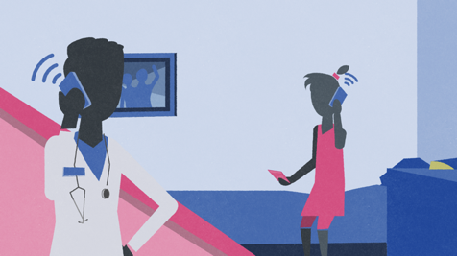
There is limited quality data assessing the effect of counselling interventions on use of contraception
However, a Cochrane Collaboration review found that special counselling plus phone calls or daily text messages can help to improve consistent use of oral contraception¹
1. Halpern V, et al. Cochrane Database Syst Rev 2011;4:CD004317.
Notes:
Speaker notes:
There is limited quality data assessing the effect of counselling interventions on use of contraception.
Structured information about hormonal side effects of injectable contraception can reduce the risk of discontinuation at 12 months (OR 0.27; 95% CI 0.16 to 0.44).
Special counselling plus phone calls increases consistent use of oral contraception at 3 months (OR 1.41; 95% CI 1.06 to 1.87); however, the effect was only limited at 12 months.
Daily text messages increases likelihood of continued PCP use at 6 months (OR 1.54; 95% CI 1.14 to 2.10) and avoid an interruption in OCP use longer than 7 days (OR 1.53; 95% CI 1.13 to 2.07).
References:
1. Halpern V, Lopez LM, Grimes DA, Gallo MF. Strategies to improve adherence and acceptability of hormonal methods of contraception. Cochrane Database Syst Rev 2011;4:CD004317.

Slide 17
Structured counselling reduces discontinuation of injectable contraception¹
Comparison of structured pretreatment and ongoing counseling of women on the hormonal effects and probable side effects of DMPA* on termination of use (n=421)
42%
Cumulative termination rate of DMPA
‘Structured counselling’ included information on hormonal effects and probable side effects of DMPA*
1. Lei ZW, Wu SC, Garceau RJ, et al. Contraception 1996;3:357-361
*Depot medroxyprogesterone acetate
Notes:
Speaker notes:
Structured counselling improves continuation of injectable contraception.¹
In a study comparing structured pretreatment and ongoing counselling of women on the hormonal effects and probable side effects of DMPA with women receiving only routine counselling, the total cumulative termination rates were 11% (23/204) and 42% (92/217), respectively (p < 0.0001) at 12 months.
The most common reasons for terminating DMPA were menstrual changes.
The authors concluded that pretreatment counseling on expected side effects increases the acceptability of DMPA.
Both the environment and the consultation can help improve continuation.
References:
1. Lei ZW, Wu SC, Garceau RJ, et al. Effect of pretreatment counseling on discontinuation rates in Chinese women given depo-medroxyprogesterone acetate for contraception. Contraception 1996;3:357-361.

Slide 18
Social media can support the delivery of contraceptive education¹
Information provided by Facebook significantly increases contraceptive knowledge and preference for long-acting reversible methods (IUC or implant) when compared with use of a traditional pamphlet
Facebook delivery included video, diagram, and game formats
Comparison of effect of counselling using Facebook or traditional pamphlet on women aged 18-45 (n=143)
% women
1. Kofinas JD, Varrey A, Sapra KJ, et al. Obstet Gynecol 2014;123(4):763-70.
Notes:
Speaker notes:
Social media can support the delivery of contraceptive education.
In a survey of English-speaking women aged 18-45 years receiving care at an urban academic center obstetrics and gynecology clinic, standard contraceptive education and a pamphlet (n=74) was compared with standard contraceptive education and use of Facebook (n=69) information for contraception counseling.
All participants received a 15-minute one-on-one counseling session with a single healthcare provider and the same information but, in the Facebook group the information was provided in video, diagram, and game formats.
The women were given 30 minutes to study the material via pamphlets or Facebook.
Delivery of information via Facebook resulted in a significant increase in contraceptive knowledge and preference for long-acting reversible methods (IUC or implant) when compared with delivery by traditional pamphlet.
References:
Kofinas JD, Varrey A, Sapra KJ, et al. Adjunctive social media for more effective contraceptive counseling: a randomized controlled trial. Obstet Gynecol 2014;123(4):763-70.

Slide 19
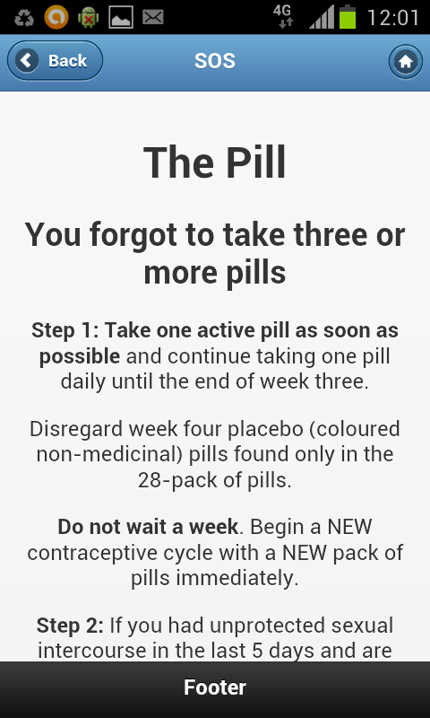
Tools are available to help maintain consistent use of user-dependent methods
Quick start regimens, where women take the first pill in the clinic and continue daily^{1,2}
Games and Apps, for example, smartphone reminders such as ‘Stay On Schedule’, offering advice on what to do pills when are missed^{2,3}
1. Westhoff C, et al. Contraception. 2002;66(3):141–5; 2. Committee on Adolescent Health Care. Obstet Gynecol. 2017 May;129(5):e142-e149; 3.Society of Obstetricians and Gynaecologists of Canada (SOGC).Available at www.sexandu.ca. Accessed 30 April 2015.
Notes:
Speaker notes
Quick start regimens, where a woman takes the first pill in the clinic and continues daily, reducing the need for counselling about when to begin contraception.¹
Games and Apps, for example, smartphone reminders such as ‘Stay On Schedule’, offering advice on what to do pills when are missed.²
References:
Westhoff C, Kerns J, Morroni C, Cushman L F, Tiezzi L, Murphy P A. Quick start: novel oral contraceptive initiation method. Contraception 2002;66(3):141–5.
Committee on Adolescent Health Care. Committee Opinion No 699: Adolescent Pregnancy, Contraception, and Sexual Activity. Obstet Gynecol. 2017 May;129(5):e142-e149.
Society of Obstetricians and Gynaecologists of Canada (SOGC). SexualityandU. (Available at www.sexandu.ca. Accessed 30 April 2015.)

Slide 20
Conclusions
Adolescent women have different needs to those of older women; they therefore need to be counselled differently about contraception
Services should be youth-friendly, encouraging access and ensuring confidentiality
Education programmes need to be holistic and not solely focused on sexual activity
There are effective interventions, including social media and smartphone use, that improve continuous and consistent use of contraception
Notes:
Speaker notes:
Adolescent women have different needs to those of older women; they therefore need to be counseled differently about contraception
Services should be youth-friendly, encouraging access and ensuring confidentiality
Education programmes need to be holistic and not solely focused on sexual activity
There are effective interventions, including social media and smartphone use, that improve continuous and consistent use of contraception
Supporting references for these concluding statements can be found in the notes sections of the slides contained within this Module.

Slide 21
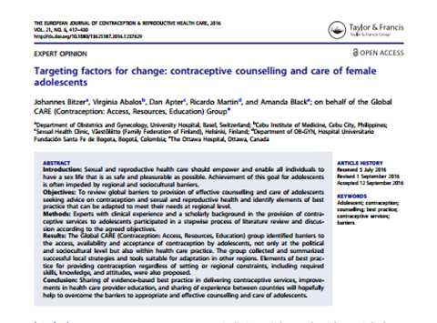
CARE materials are available to download from www.your-life.com
Checklist
4x patient cases
Publication
2 animated videos
3x slide modules
Notes:
Direct HCPs to resources already available on www.your-life.com and open access publication online.

